Slide 1
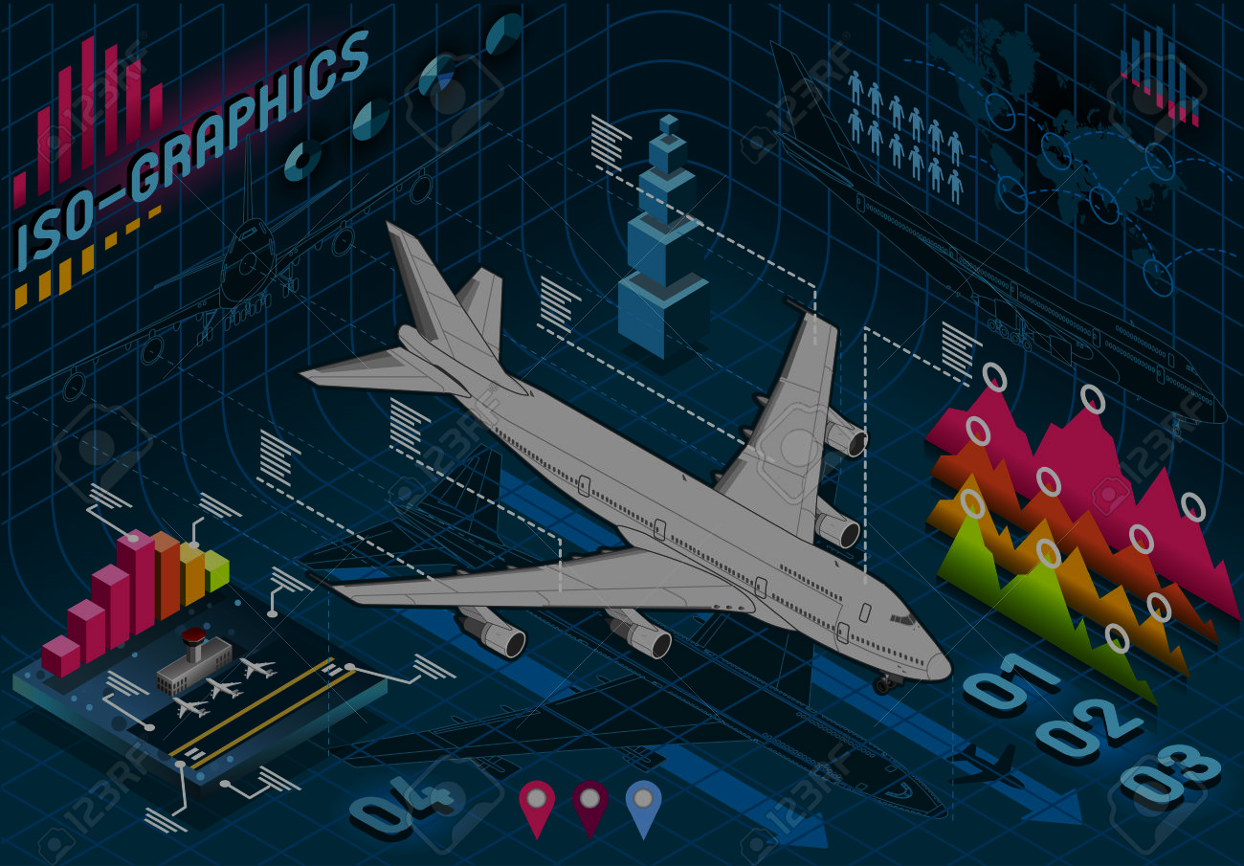
BUAN 6356 Term Project GROUP 14
JOB (JJK210000) RIDDHI (RXS210059) RATNAM (RXS210049)
RAJDEEP (RXK210033) PAVAN (PXU210003)

Slide 2
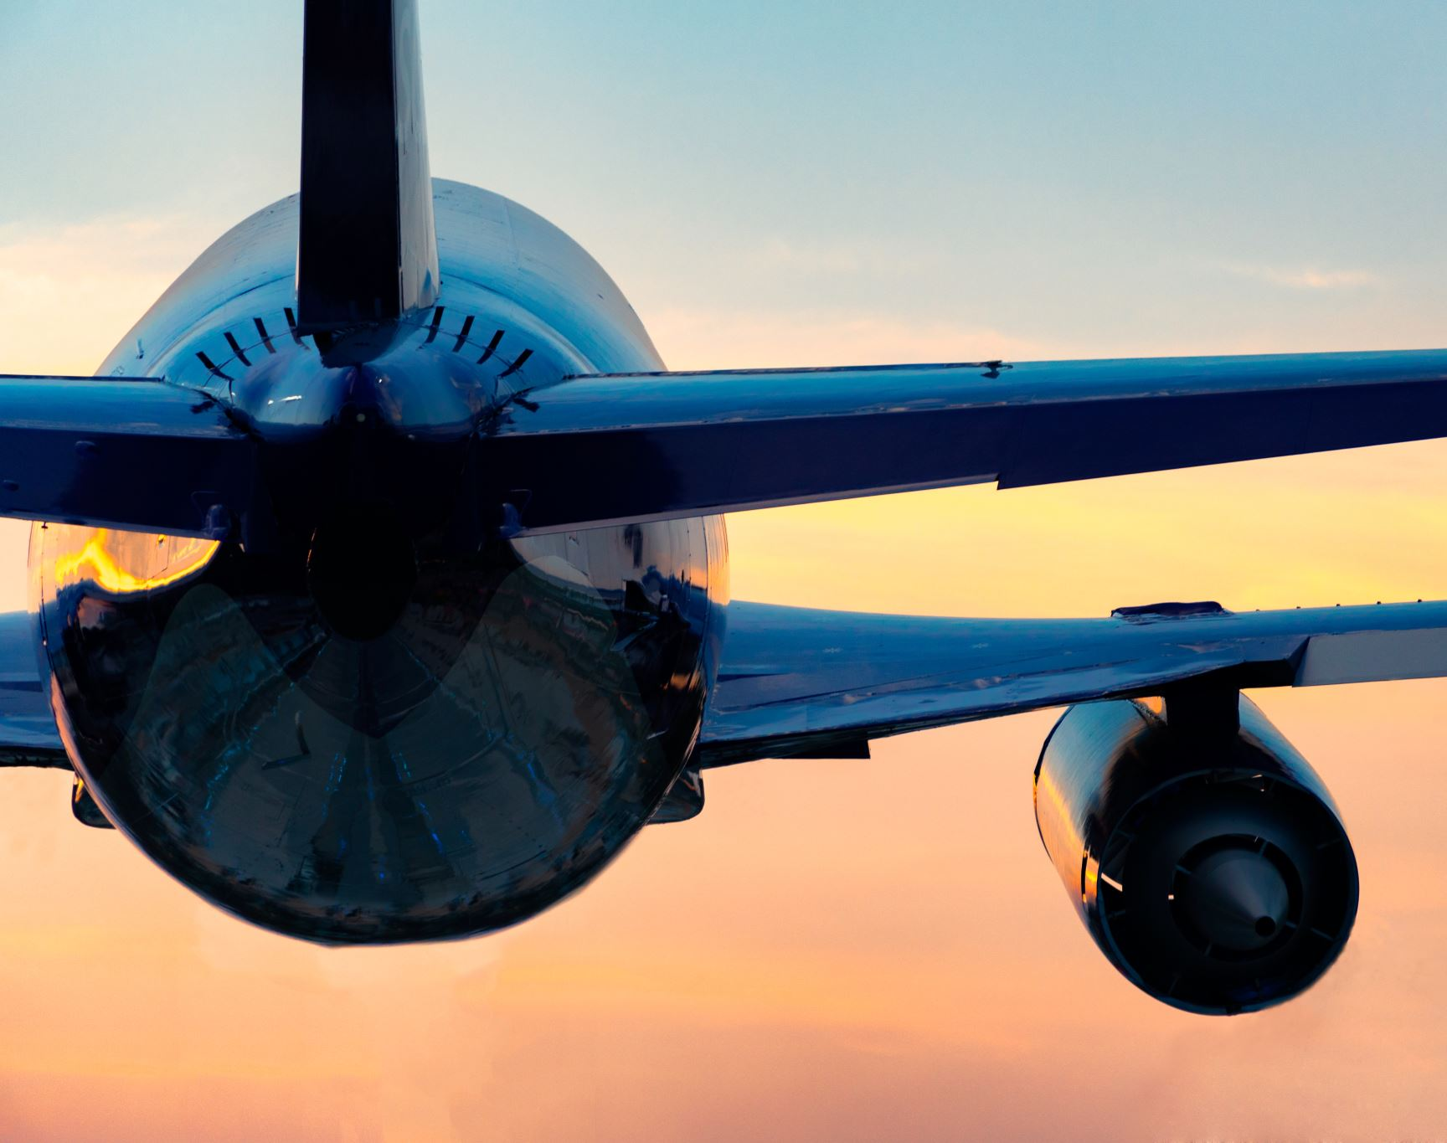
Executive Summary
The general objective of this study was to examine the influence of airline service quality on passenger satisfaction and loyalty.
The goal of the project is to garner new customers without losing sight of its existing customers. Our model intends to aid the airlines in achieving this goal by predicting customer satisfaction and providing recommendations to improve customer satisfaction.

Slide 3
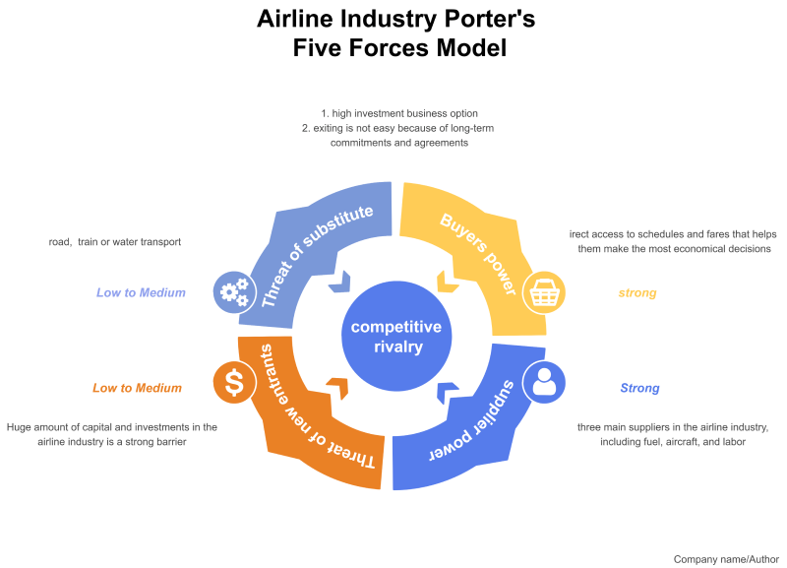

Slide 4

Porter’s Five Forces
Competitive Rivalry: Since airline industry is expensive, the rise in competitors is comparatively less phenomenal. Factors for the competition can be given as:
High competition among similar size companies.
Rivalry for market share.
Pressure to sell at a low margin for revenue.
Difficult to compete on common grounds due to different goals.
The threat of New Entrants: New entrants can add new capacity in the market and reduce the prices. They may use lower pricing by reducing extra costs and offering innovation to put pressure on the airline industry. Better Infrastructure, efficiency, and very high product quality could act as a threat to brand image and loyalty.

Slide 5
Porter’s Five Forces
Bargaining Power of Suppliers : Airline industry mainly depends on fuel, aircraft and labor. Fuel is not fixed and fluctuates on external factors. Aircraft is supplied by Airbus and Boeing, so bargaining power plays big role here. Labor is affected due to union politics and demands.
Bargaining Power of Customers : Airlines industry has been very competitive in terms of attracting customers. Online ticketing and third-party platforms to book flights have given customers the power to compare and choose among airlines.
Threat of Substitute Products : Considering other means of travel, which are comparatively cheaper could be a threat to airlines industry. However, air travel cannot extinct as it is the best option for long distance and quick travel. This factor is more impactful in regional travel, where short distance makes road and train travel more economical. In international travel, this factor has a very minimal effect.

Slide 6

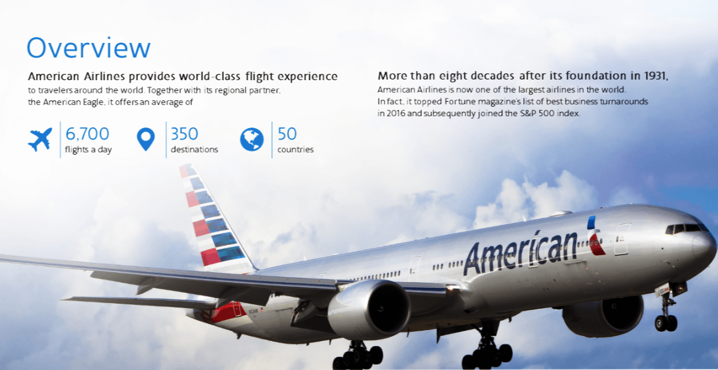
American Airlines:

Slide 7
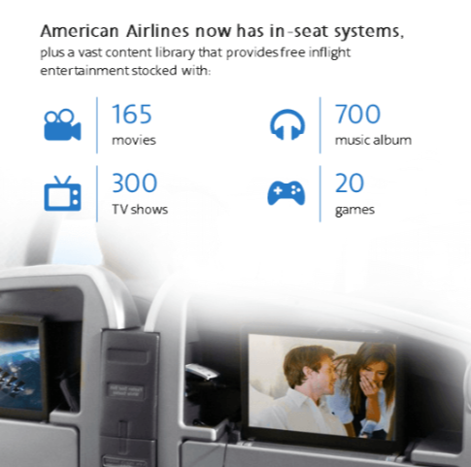
American Airlines Services:
American Airlines is world's largest airline when measured by fleet size, scheduled passengers carried, and revenue passenger mile.
It has around 123,400 employees all around the world and a Market Capital of 12.19 Billion.
Some of the features of this airlines is given below:
Provides In-Flight Internet service.
Complimentary buy on board meals
Provide best known Flagship Lounges.
Flight changes incur fee charges.
Fuel surcharges on BA tickets.

Slide 8
SWOT Analysis:
STRENGTHS Brand value in the market Largest global airline in terms of passenger traffic. Routes serving all corners of the globe. Government relations. Highest Revenue Making Airlines | WEAKNESS Internal flight amenities draining profits. Inability to compete with low-fare carriers on price. Charging for small amenities such as luggage. Unprofitable routes. Highest Debts
OPPORTUNITIES SABRE ticketing system for customer ease of booking. Rewarding route structure. Government backed loans. Partner with other airlines around the world. | THREATS Low operating margins favoring low fare carriers. High Fuel prices. Government intervention. Inaccessible to casual travellers due to price.

Slide 9

GOALS AND OBJECTIVES
The goal of the model is to predict whether a new customer of the airline would be (Neutral/Dissatisfied) or Satisfied
American airlines faces trouble in attracting new customers and retention of existing customers. To solve this problem, we need to understand customer demands to improve service and quality to provide better customer experience and garner more customers.
To implement this, we aim to use supervised learning with the help of historical customer experience data. Our model intends to aid the airlines in achieving this ultimate goal through following strategies:
Retention Strategy - The model intends to help to all airlines who want to keep track of how satisfied the customers are with the service. And suggest areas of improvement.
New Customer -Additionally, this model helps an airline predict the possible satisfaction level of a new customer based on the historical data available.

Slide 10
Business Understanding
1. American Airlines, headquartered in Fort Worth, Texas, is the world's largest airline in terms of fleet size, scheduled passengers carried, and revenue passenger mile.
2. Customers purchasing plane tickets account for the majority of revenue
3. Majorly revenue is driven by customers paying for flight tickets.
4. However, the costs of running a passenger airline are enormous. To break even on a transcontinental flight, the airline must receive $300 per seat on average.

Slide 11
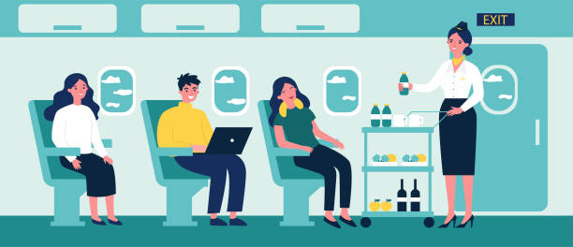
AMERICAN AIRLINES DATASET
With over 6,800 flights per day to nearly 350 destinations in more than 50 countries, our dataset is estimated to be for about one week because not all customers provide reviews and feedback.
As of April 2022, there are reported to be 123,400 employees working for American airlines around the world.

Slide 12
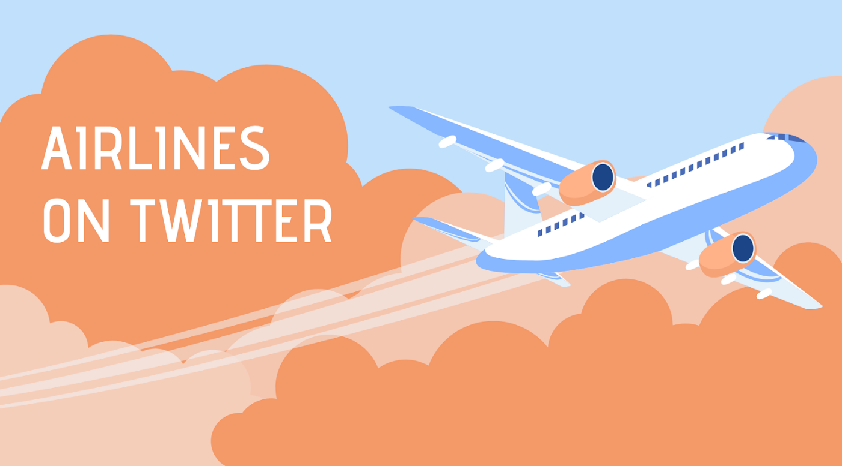

Slide 13
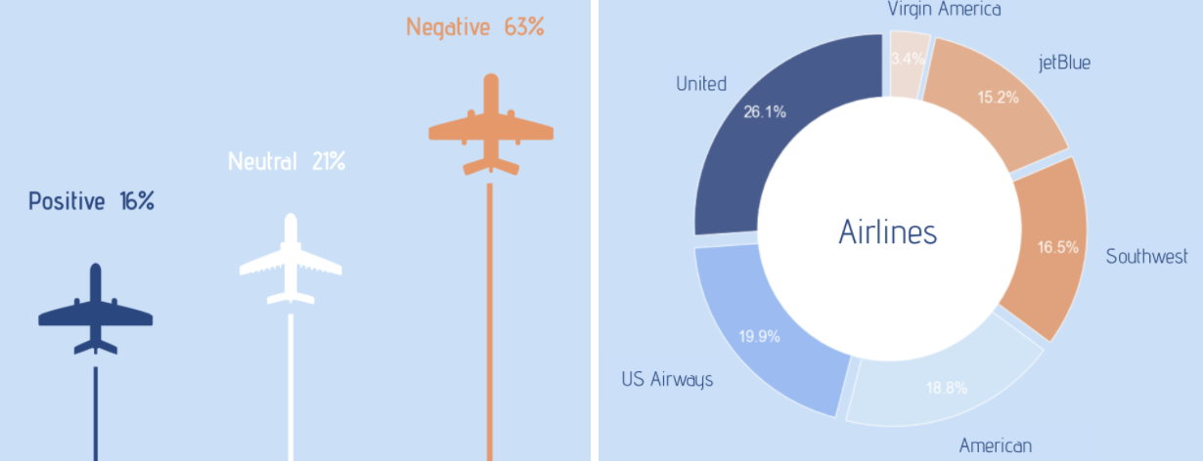
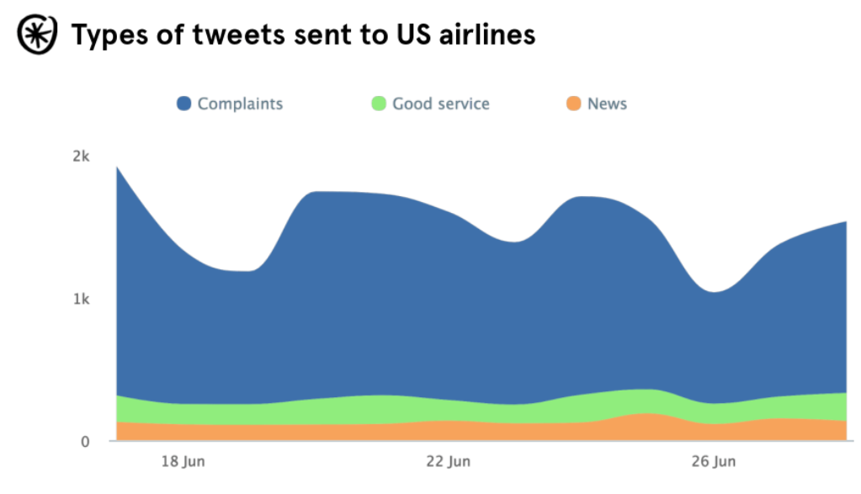
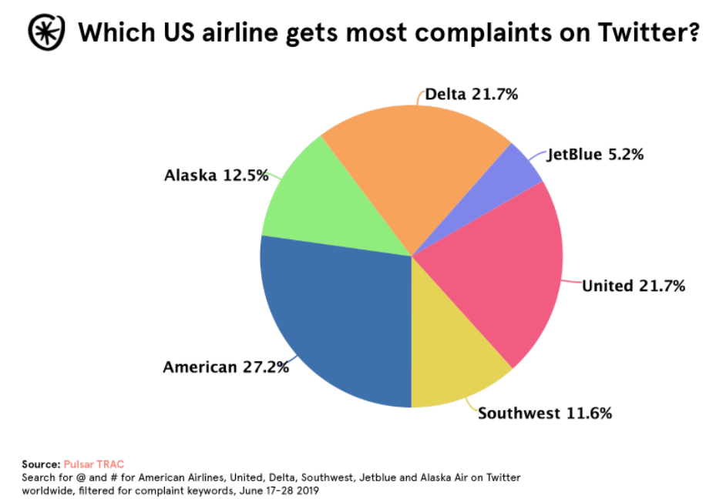
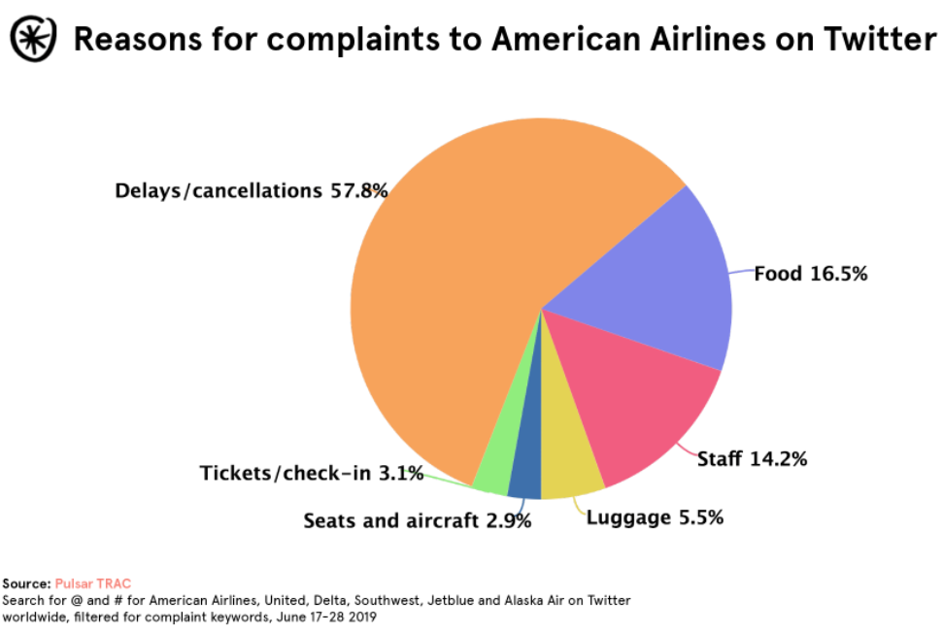
Understanding Customer Complaints
LINE OF BUSINESS :
1. American Airlines has the highest number of flights and passengers.
2. Therefore, also the highest complaints on Twitter. (by a margin)

Slide 14
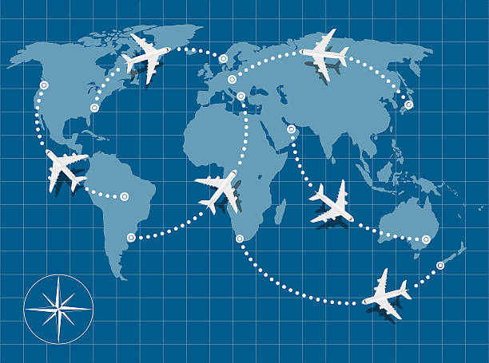
American Airlines has one of the widest flight networks in the world covering all continents including Asia, Australia, and Africa.
As of November 2021, American Airlines flies to over 350 domestic destinations and 95 international destinations in over 50 countries.
GEOGRAPHICAL FOOTPRINT

Slide 15
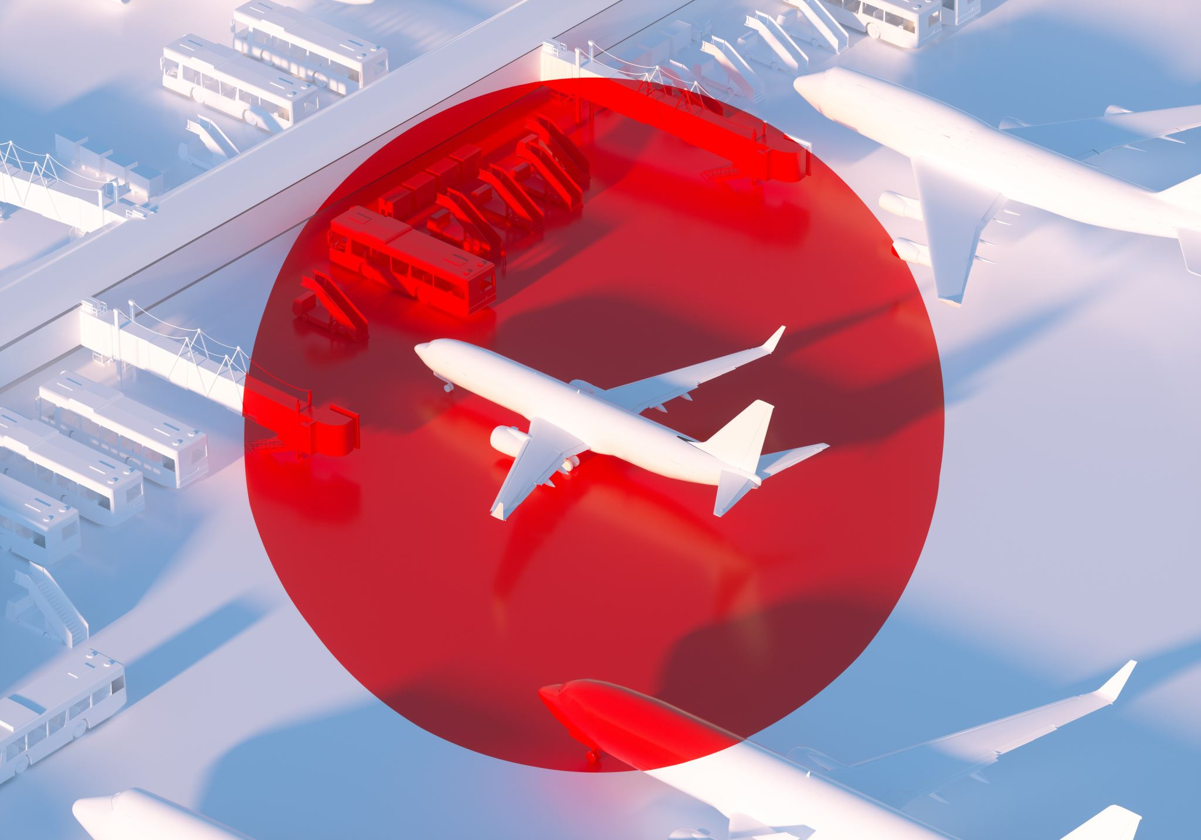
Airfares: Revenue generated from the sale of flights Cargo: Revenue generated from transporting freight or mail in addition to passengers. Ancillary: Additional fees that are sometimes charged to passengers for extra services such as seat allocation, additional baggage, meals, and access to an in-flight entertainment system or in-flight Wi-Fi Loyalty/Frequent Flyer Programs: Revenue generated from frequent flyer programs or consumer credit cards offered by the airline
Revenue Sources

Slide 16
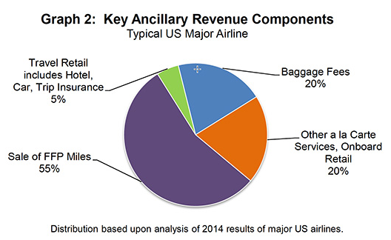
As auxiliary services offer the most room for revenue optimization compared to other sources, the strategy is to assess which services may be improved in terms of customer happiness while also increasing income.
Why Ancillary ?

Slide 17
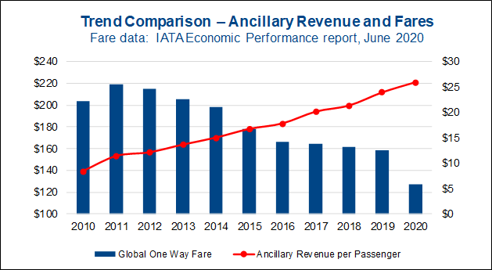
Although airfares account for a significant portion of revenue, the factors that regulate them are difficult to adjust or optimize because they are governed by government rules, fuel prices, and competitive pricing In 2020, American Airlines will have a total revenue of $17.3 billion. Ancillary revenue is anticipated to be 3.7 billion, which is still a significant portion of total revenue Attempting to lower the airfare in order to attract more consumers would have a significant impact on the airline's revenue. As a result, auxiliary services are taken into consideration
REVENUE TIED TO SERVICES

Slide 18
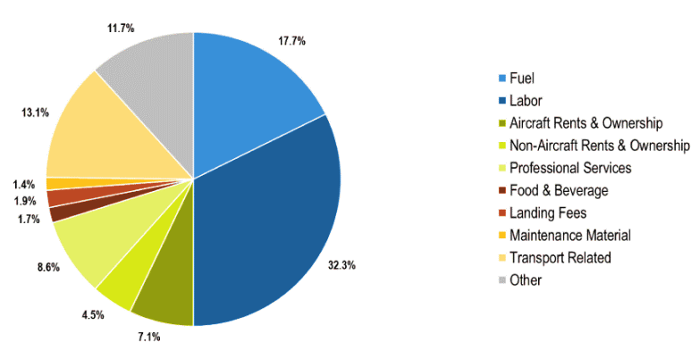
Operational Cost
An average Airlines in the US has Labor and Fuel covering more than 45 % of the operational cost, whereas Professional Services and other only comprise of 19.3% of the total.
Therefore, there is room for those services to be increased or optimized.

Slide 19

Part 3-Data Analysis And Understanding

Slide 20
LINK TO THE DATASET
https://www.kaggle.com/datasets/teejmahal20/airline-passenger-satisfaction

Slide 21

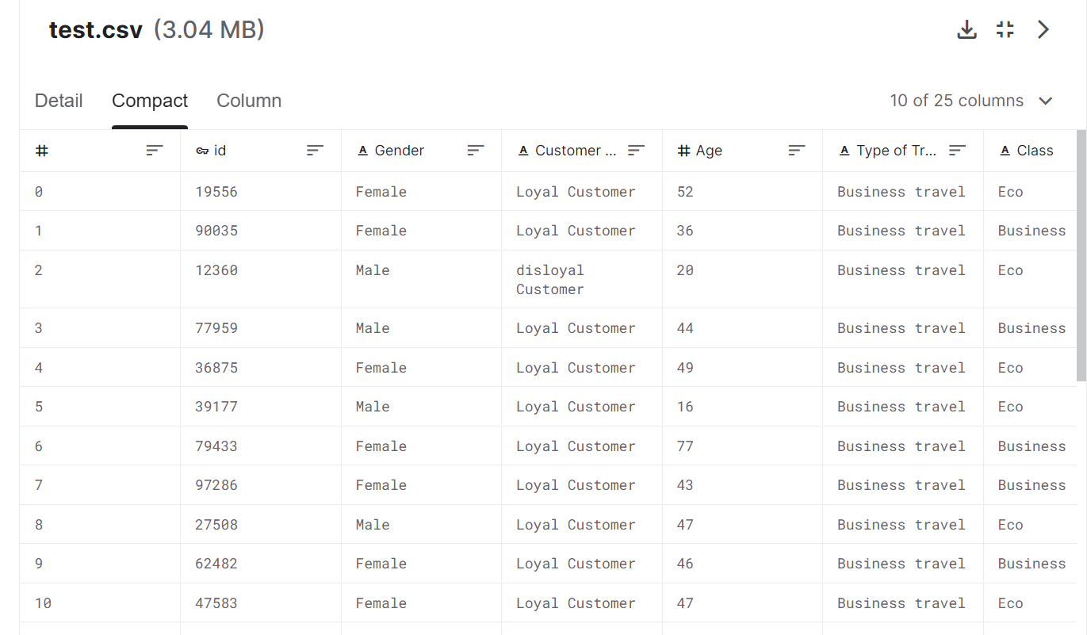
Dataset Analysis
This is dataset consisting of customer’s flight experience with American Airlines (for a week during the month of November’19). Each row represents the rating provided by a customer based on his/her one-way flying experience with the airlines. There are total 25976 records of customers and their experience.

Slide 22

Variables in action
Independent Variables:
Gender: Gender of the passengers (Female, Male)
Customer Type: The customer type (Loyal customer, disloyal customer)
Age: The actual age of the passengers
Type of Travel: Purpose of the flight of the passengers (Personal Travel, Business Travel)
Class: Travel class in the plane of the passengers (Business, Eco, Eco Plus)
Flight distance: The flight distance of this journey
Dependent Variables:
Satisfaction: Airline satisfaction level(Satisfaction, neutral or dissatisfaction)

Slide 23
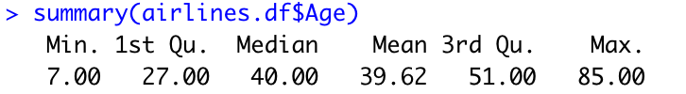
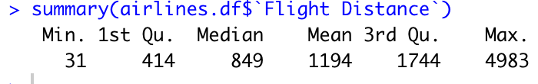
Summarizing the dataset
Summarizing the numeric data in the dataset
Age
Descriptive statistics of age
Flight_Distance
Descriptive statistics of Flight_Distance

Slide 24
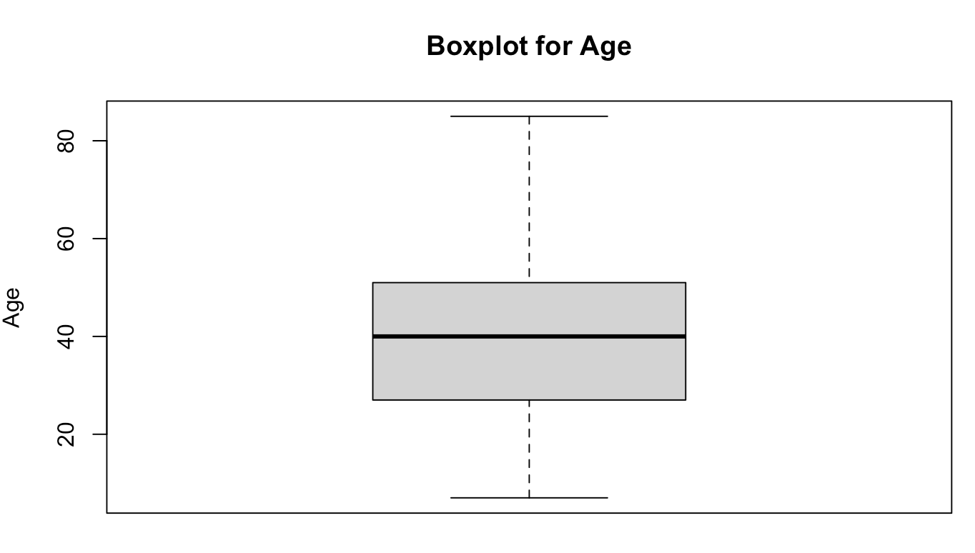
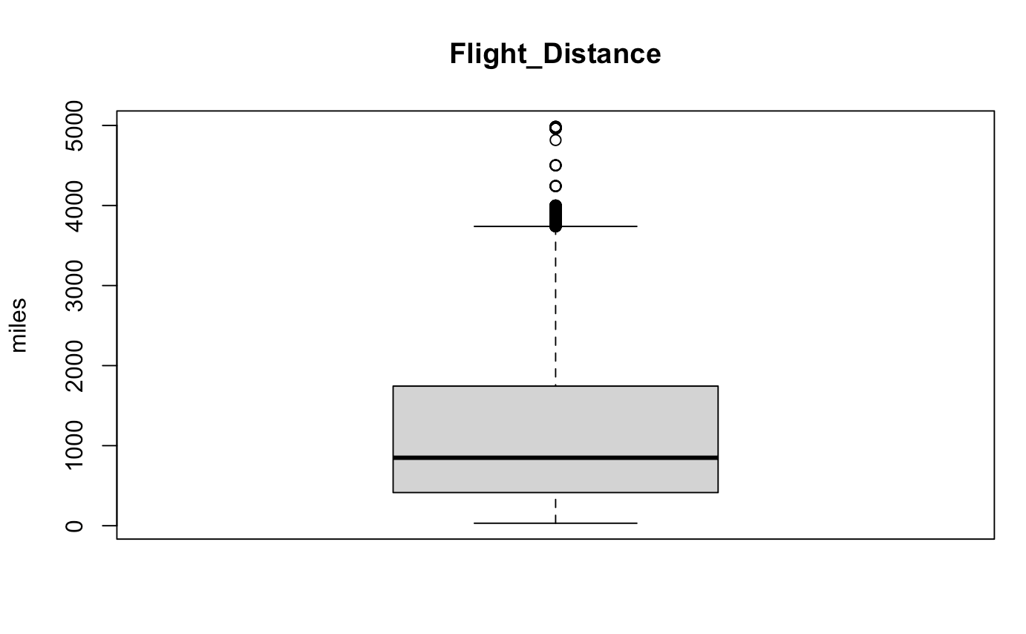
Summarizing the dataset
Summarizing the numeric data in the dataset
Age -Boxplot of age Flight_Distance – Boxplot

Slide 25
Summarizing the dataset
Correlation

Slide 26
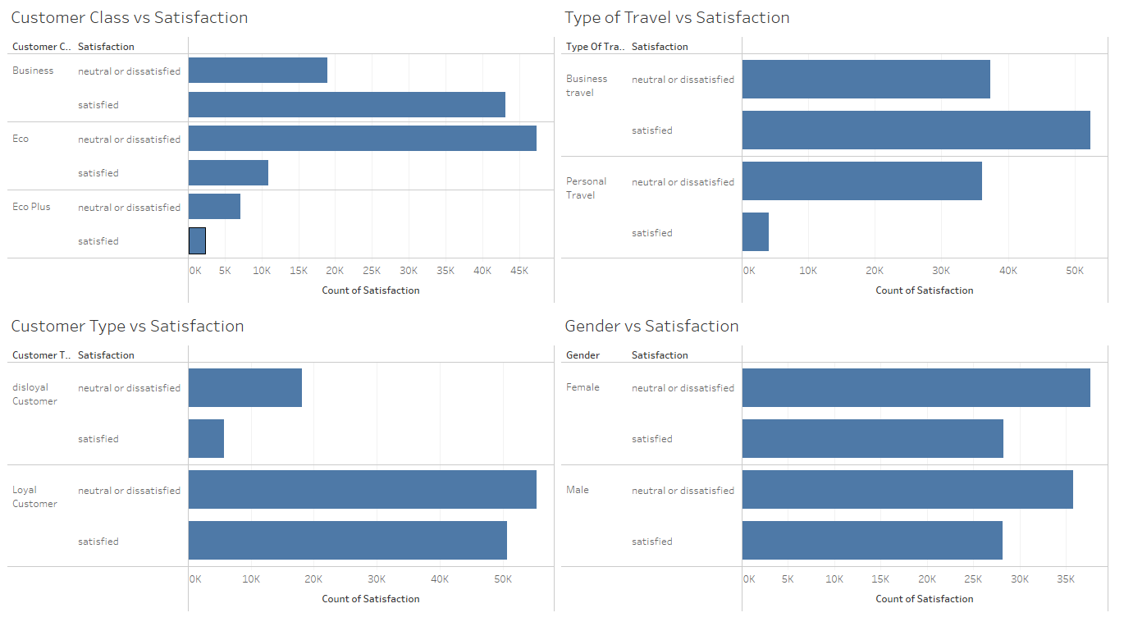
Notes:
Business class is most satisfied as they get the best services and hospitality. Loyal customers have higher values of neutral or dissatisfied ratings therefore, it is vital that service ratings may be enhanced.

Slide 27
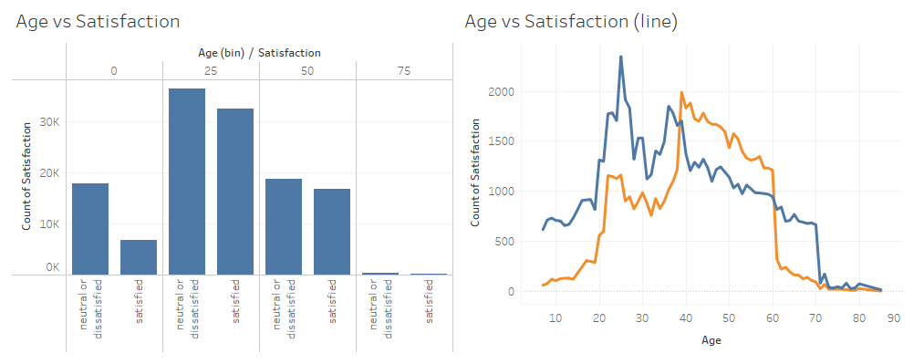
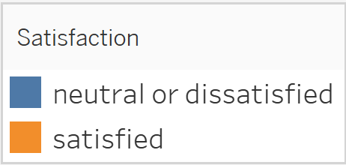
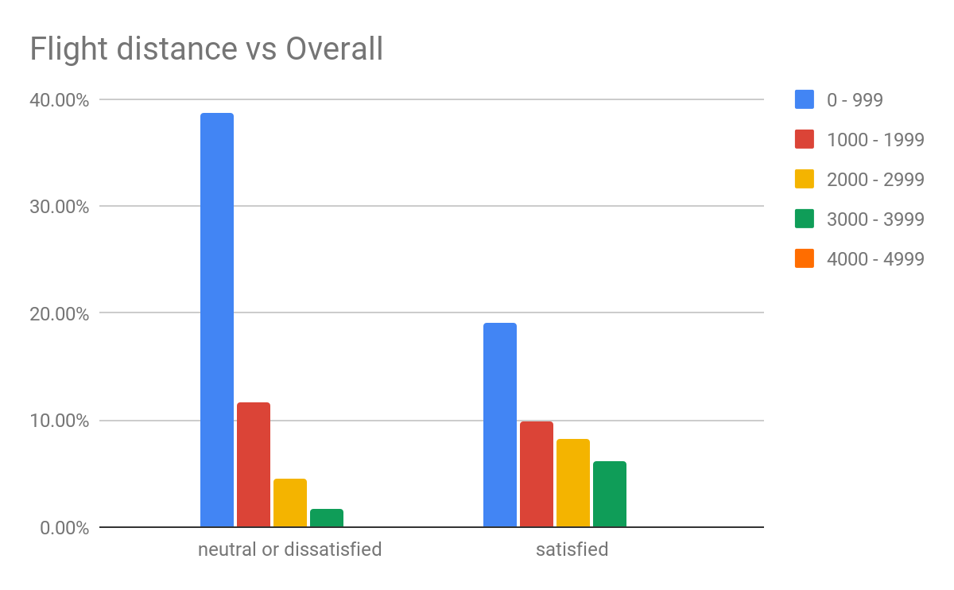

Slide 28
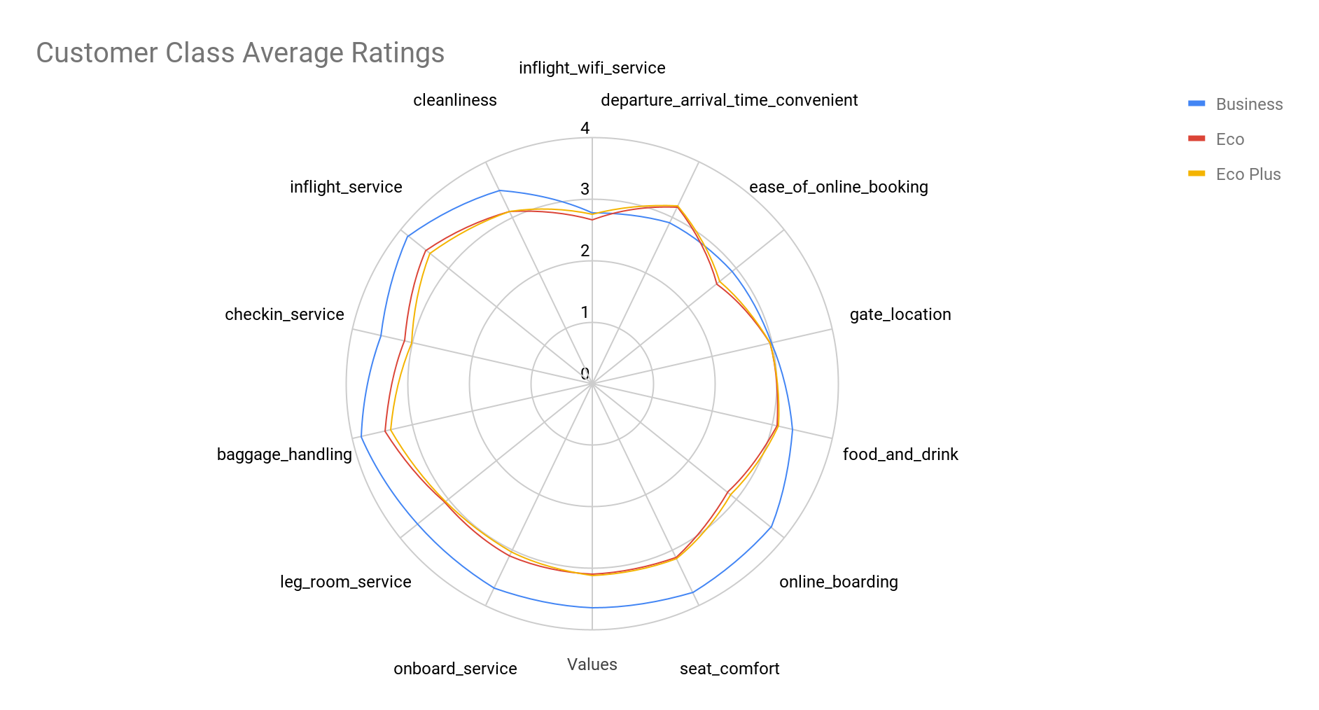
Business-class passengers’ ratings are better than Eco & Eco Plus passengers, except for ease of online booking where there is a contrast in the ratings.

Slide 29
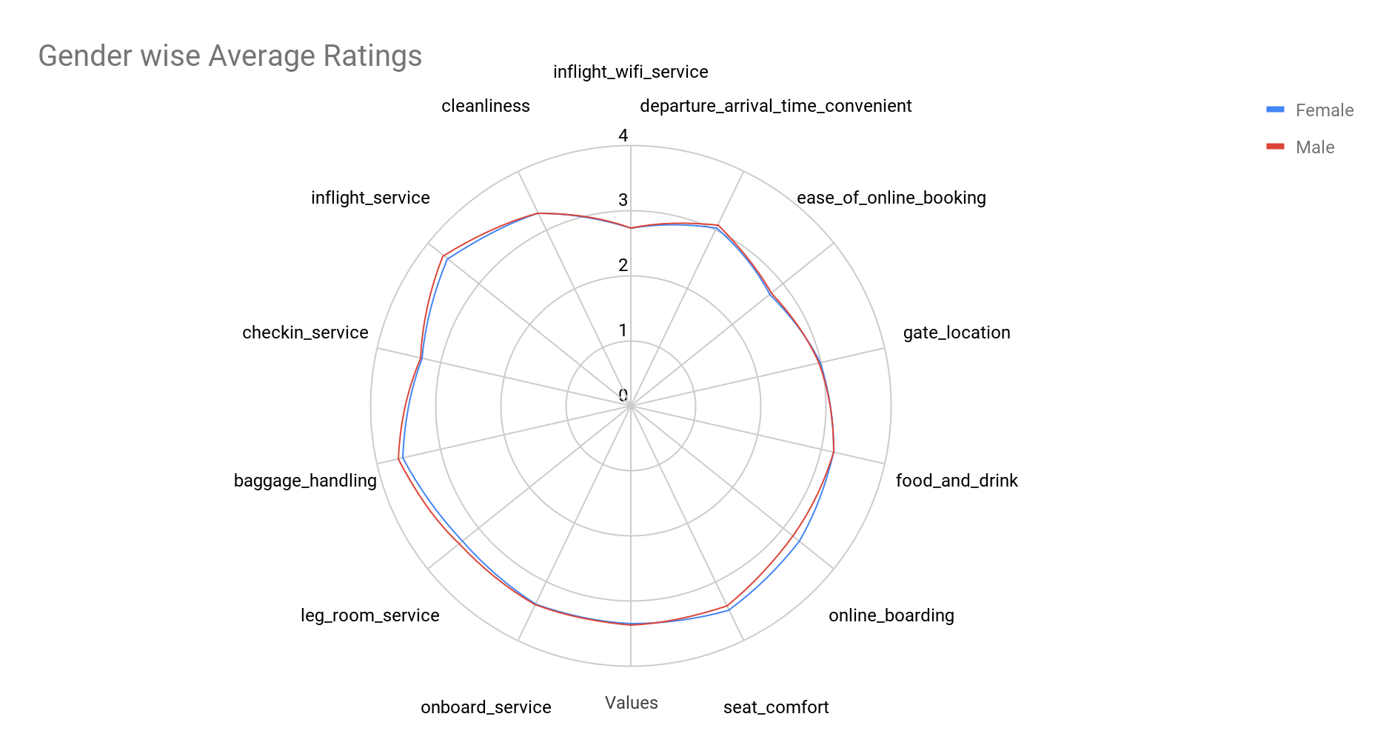
On the basis of gender, the ratings don’t vary much.

Slide 30
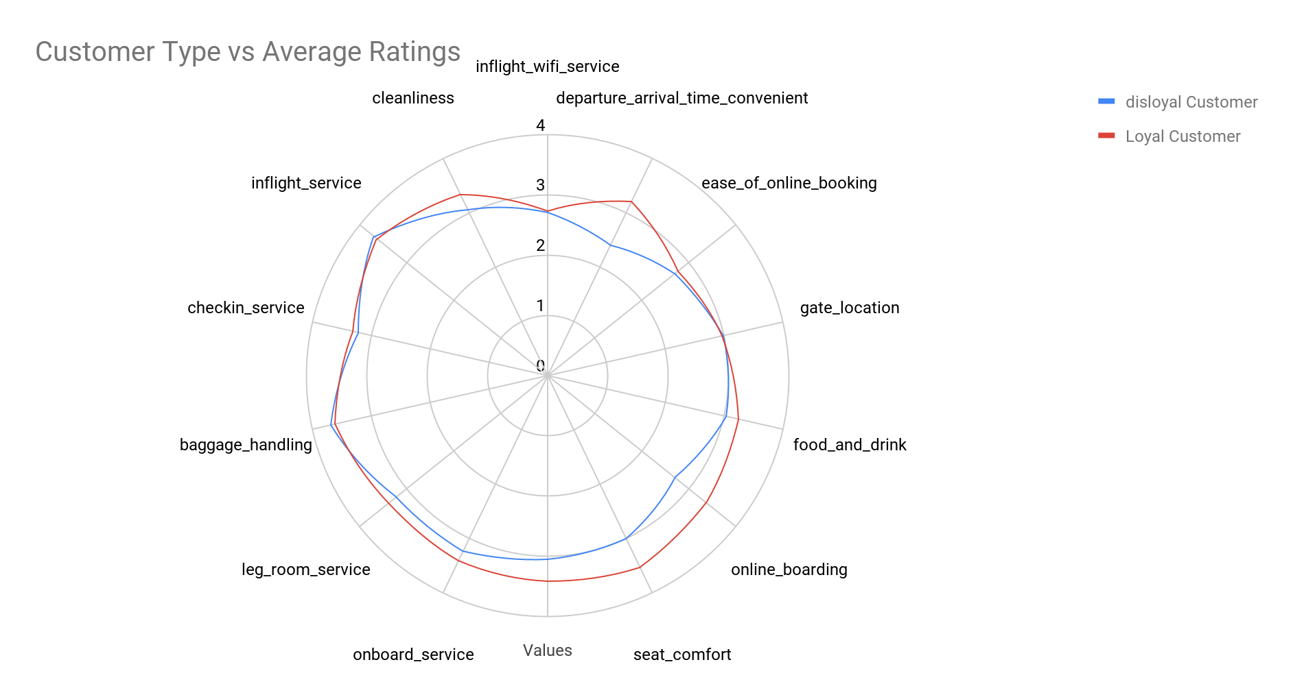
Loyal customers appreciate the comfort, boarding process, and onboard services better than the disloyal customer.
Probably because they get better discounts and offers on onboard services and seats.

Slide 31
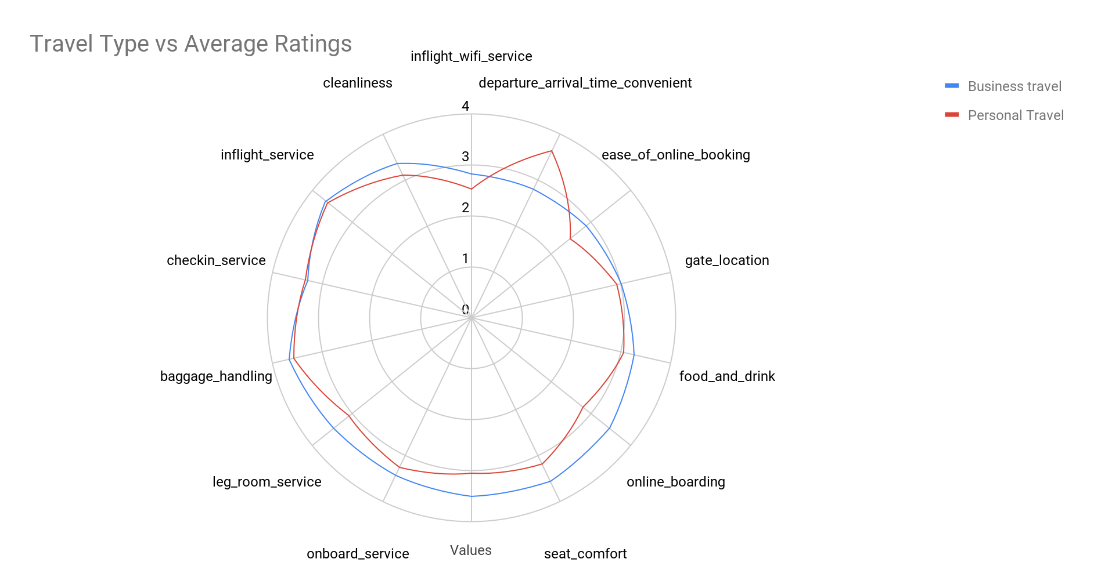
Passengers traveling for personal reasons think the departure & arrive time convenience is suitable.

Slide 32
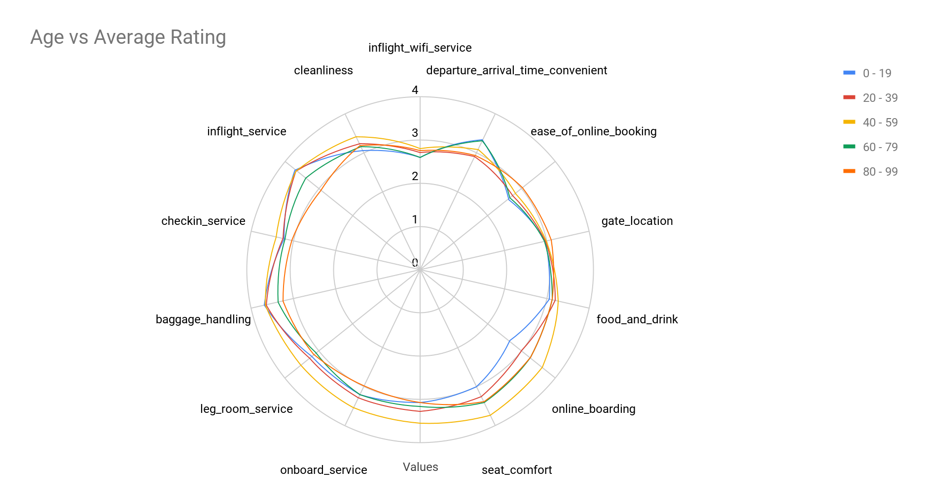
Ages 60-79 rate the time convenience the highest as compared to other age groups.

Slide 33
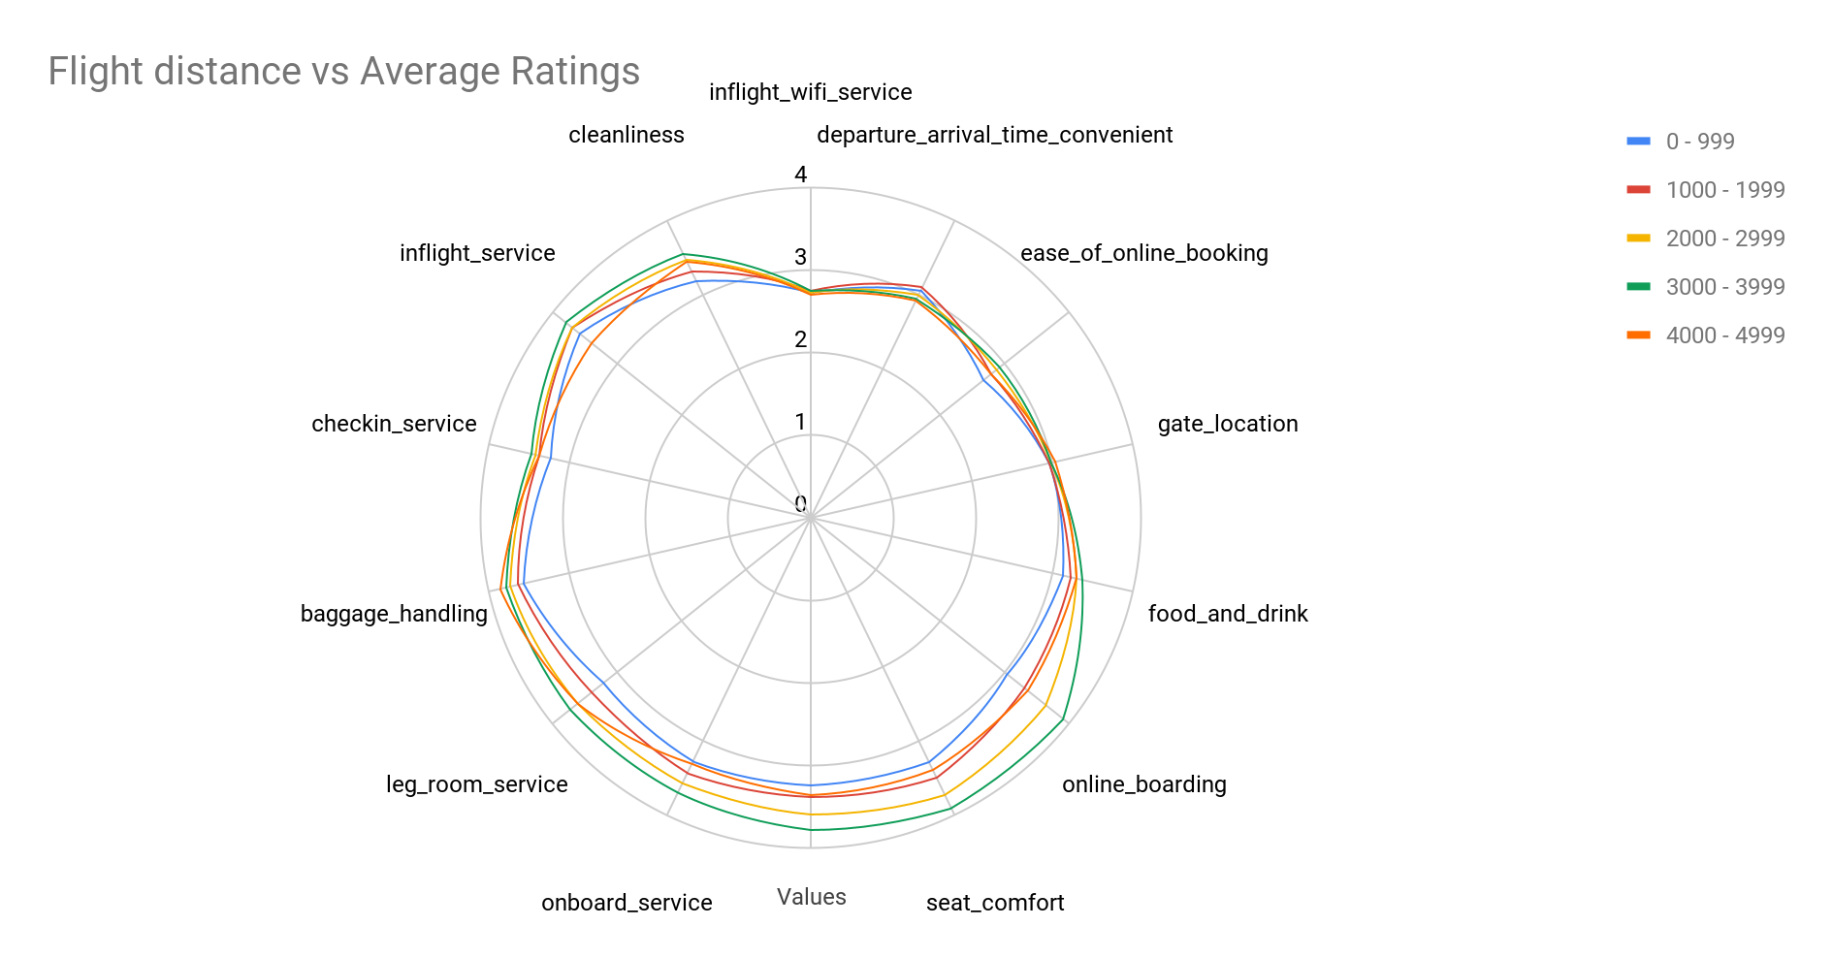
Passengers who have covered between 3000-3999 Flight distances rate much higher on comfort and online boarding process.

Slide 34
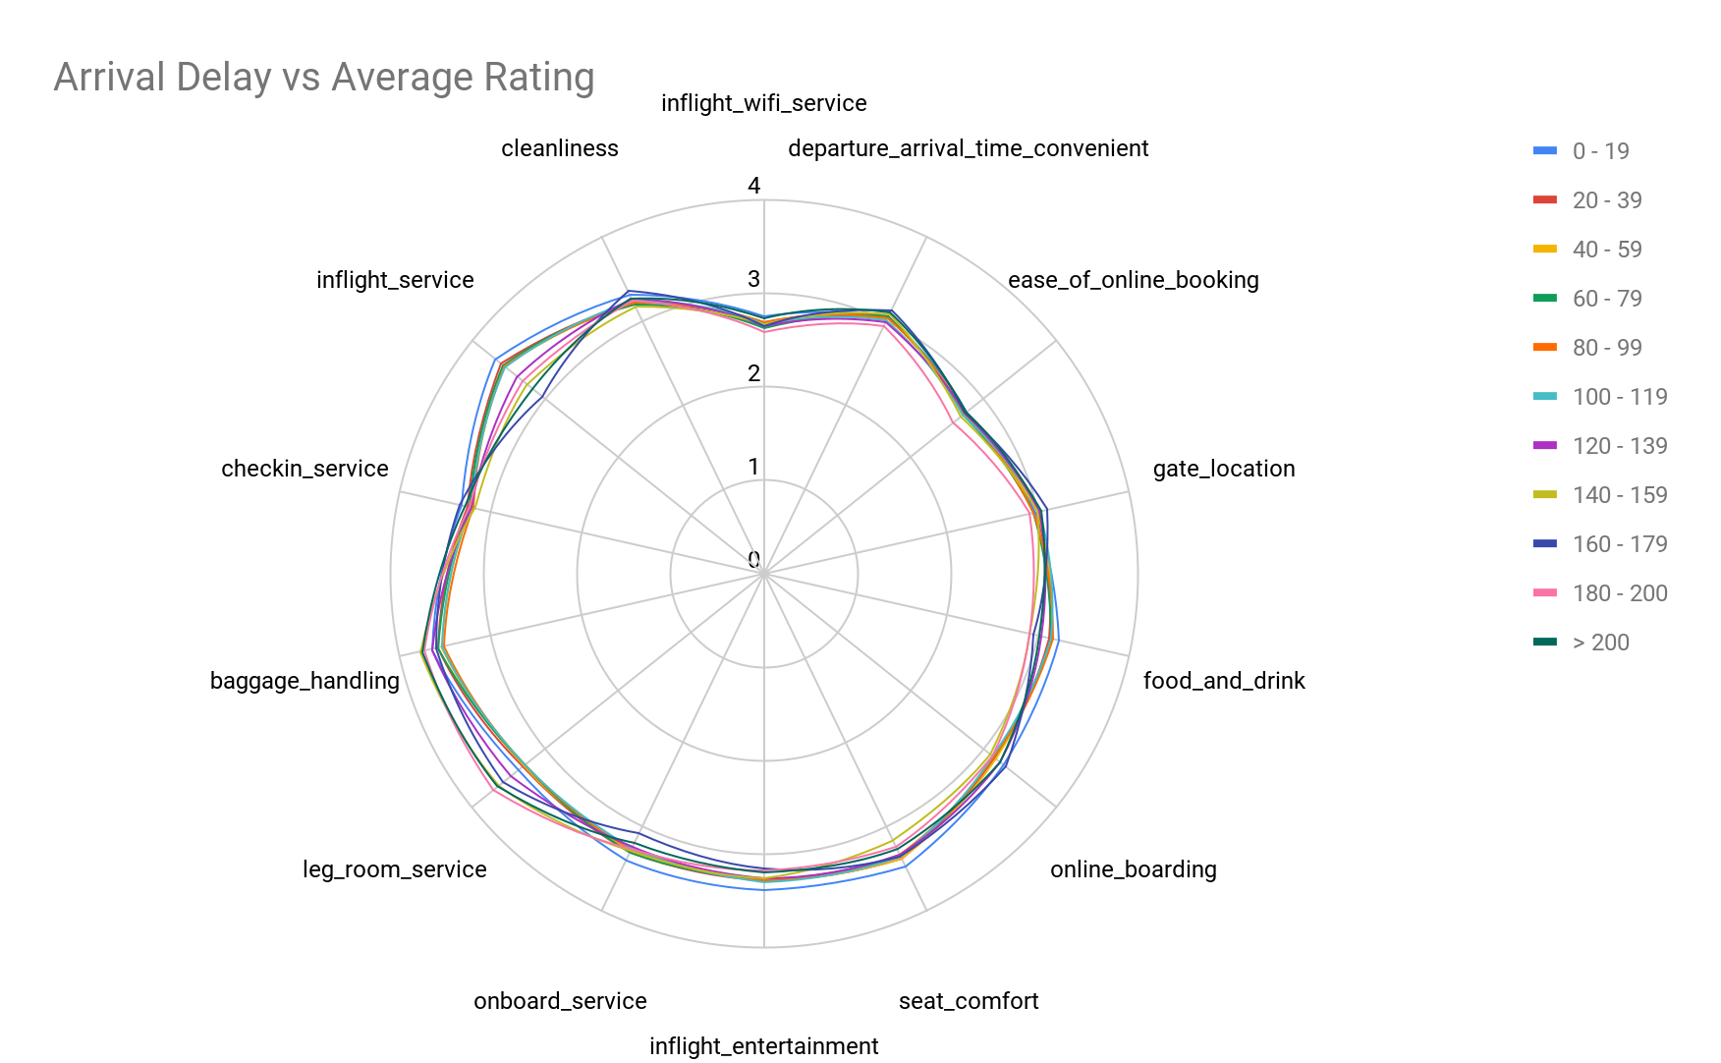
Arrival delay is not a significant variable as it doesn’t affect the ratings too much

Slide 35
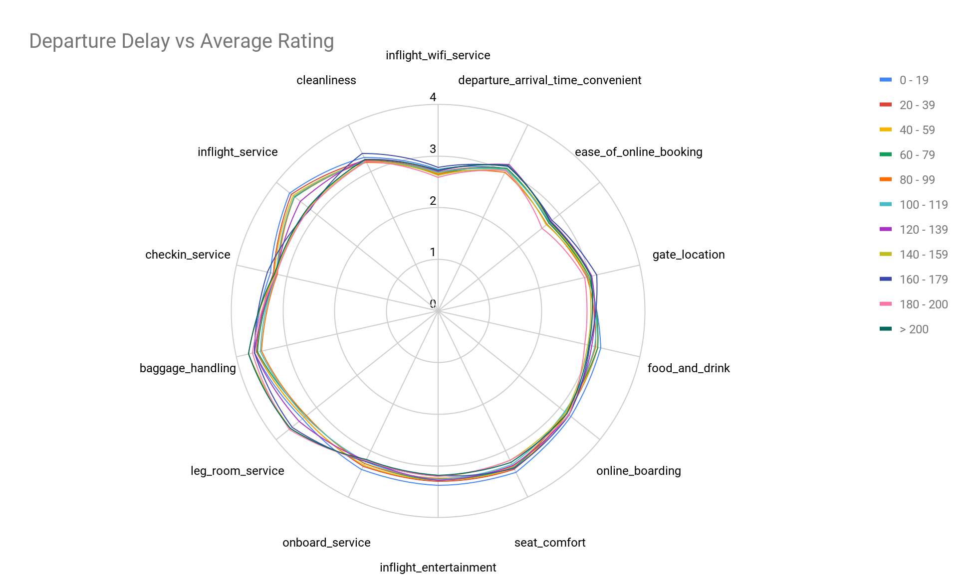
Departure delay is not a significant variable as it doesn’t affect the ratings too much

Slide 36
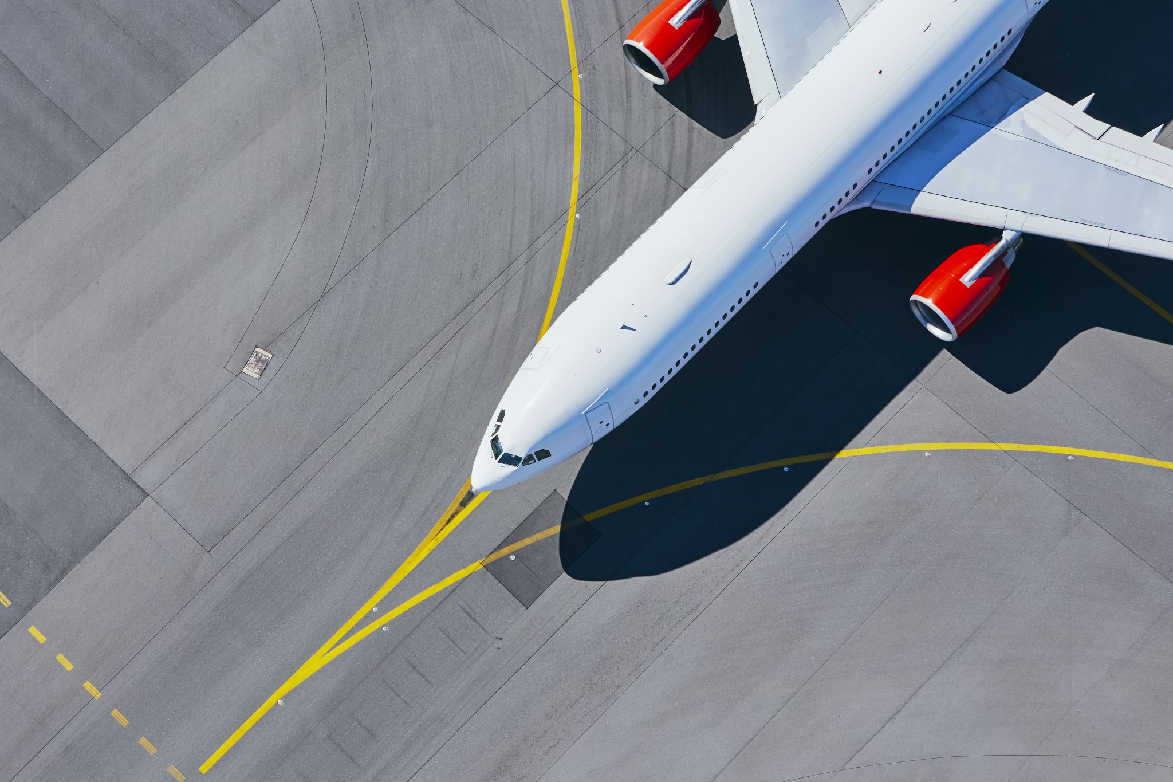
PART 4: DATA MODELLING

Slide 37
GOAL OF THE MODEL
1. The goal of the model is to predict whether a new customer of the Airlines would be (Neutral/Dissatisfied) or Satisfied
2. Our target variable is Satisfaction which has two values (Neutral/Dissatisfied) and Satisfied

Slide 38
OBJECTIVE OF THE MODEL
1. The goal of the model is to predict whether a new customer of the Airlines would be (Neutral/Dissatisfied) or Satisfied
2. Our target variable is Satisfaction which has two values (Neutral/Dissatisfied) and Satisfied

Slide 39
WHAT WE HOPE TO ACCOMPLISH WITH OUR PREDICTIVE MODEL
1. To maximize the customer retention rate of American Airlines by suggesting offers and upgrades to the predicted Neutral/Dissatisfied Customers
2. We hope to convert the (Neutral/Dissatisfied) to Satisfied Customers

Slide 40
BUILDING THE MODEL
Following data transformations are done:
Factorized the following columns Gender, customer_type, type_of_travel, customer_class, satisfaction
There are no null values in the dataset
Removed the first column which was just the Id’s
Split the Data into 60 - 40 Train and validation set
Scaling of dataset not required for the dataset
After all the Data pre-processing we split the data into 60% - 40% train and validation sets and used these sets to train multiple models

Slide 41
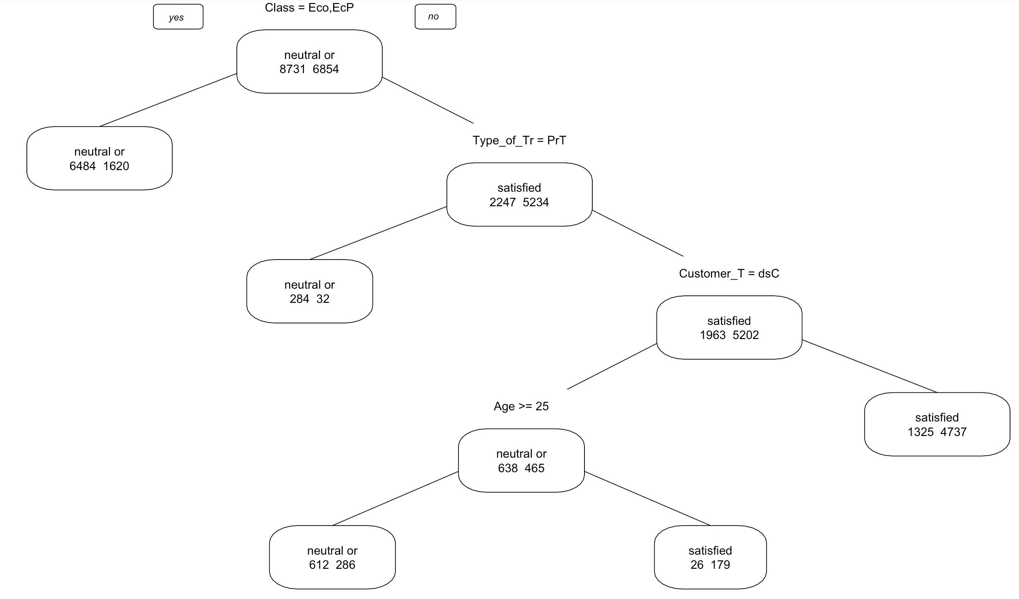
DECISION TREE

Slide 42
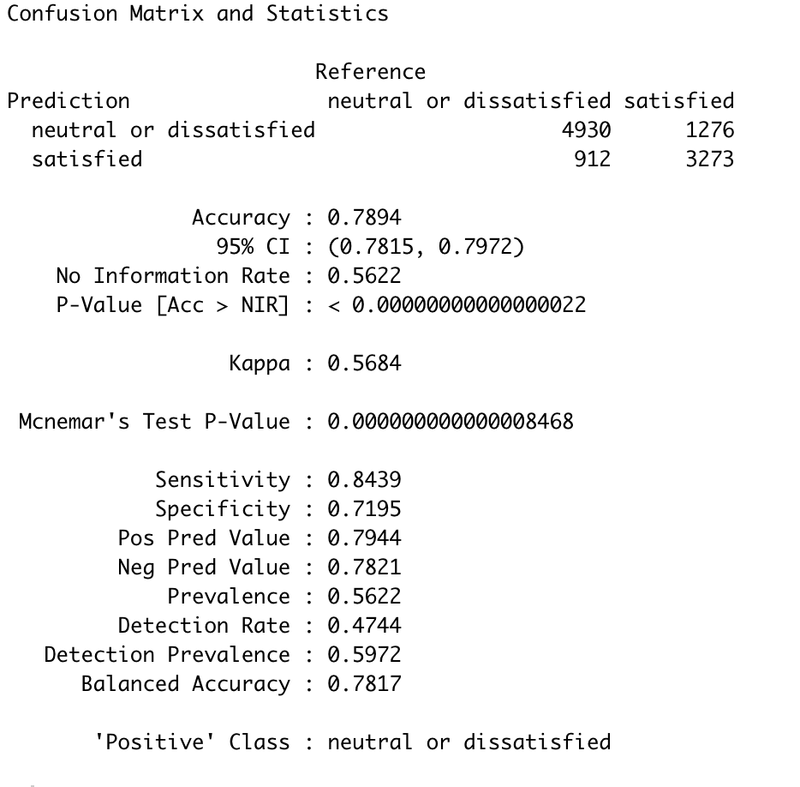
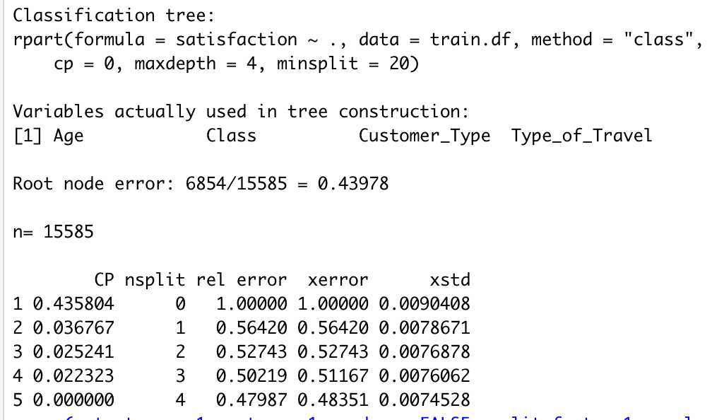
Summary Statistics & Confusion Matrix: Decision Tree

Slide 43
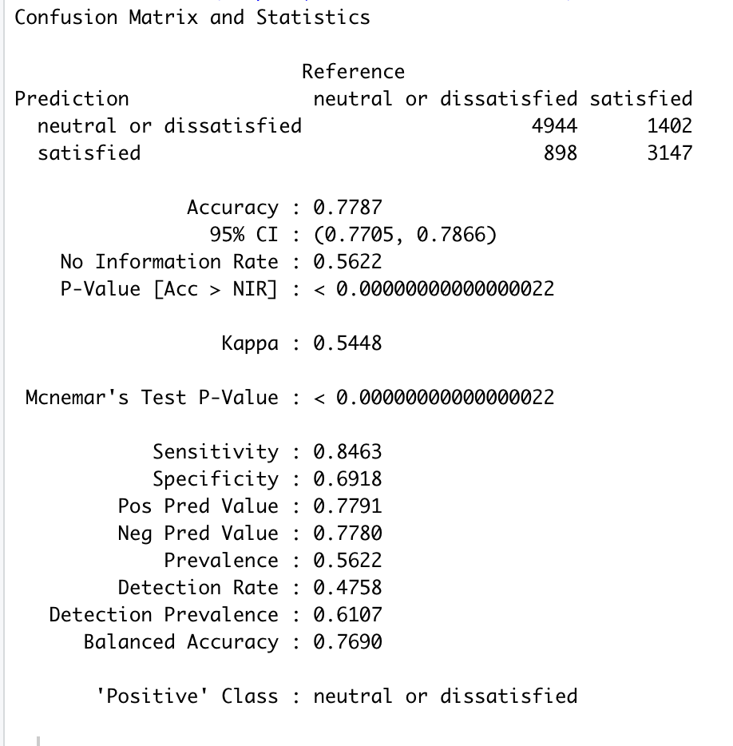
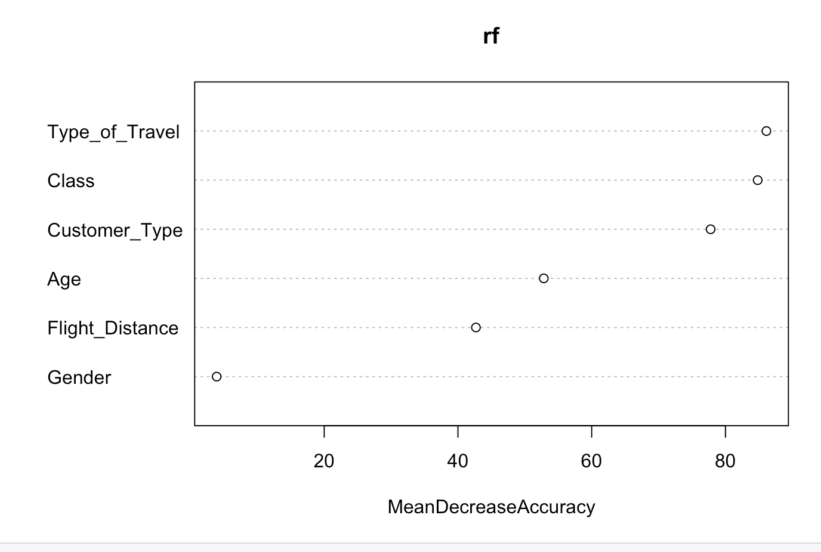
Confusion Matrix: Random Forest

Slide 44
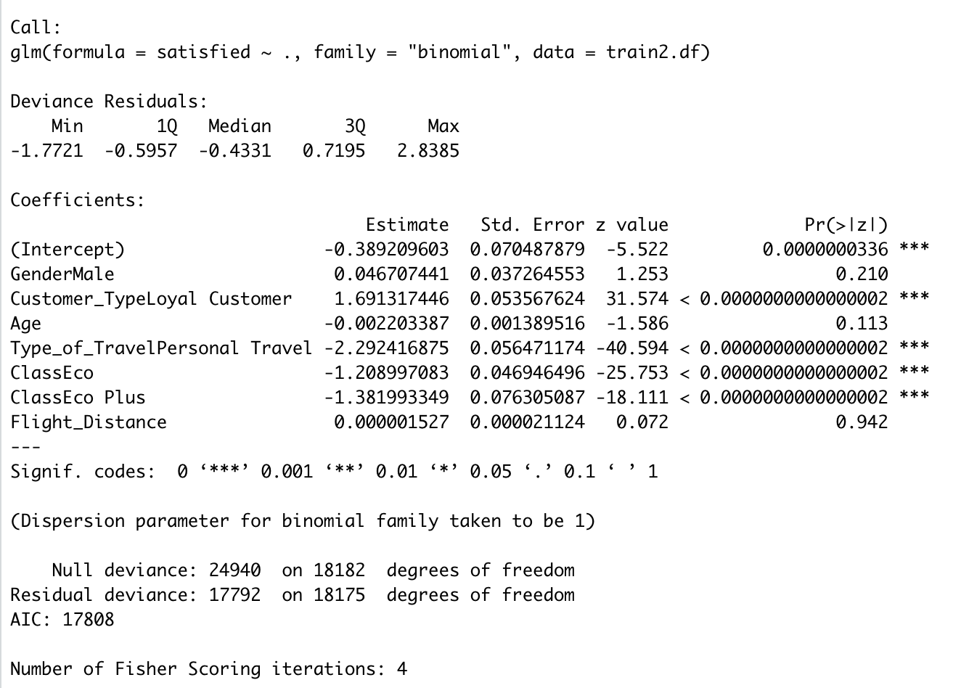
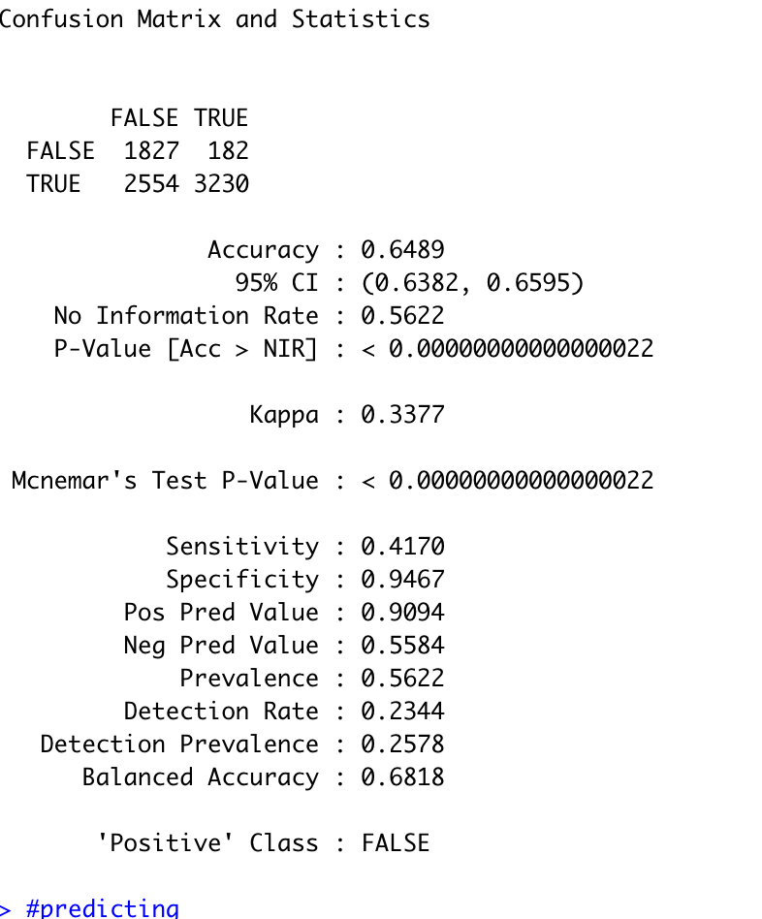
Summary Statistics & Confusion Matrix: Logistic Regression

Slide 45
ACCURACY RATE AS PER CONFUSION MATRIX
MODEL | ACCURACY | TRUE POSITIVE | FALSE POSITIVE | TRUE NEGATIVE | FALSE NEGATIVE | POSITIVE CLASS
DECISION TREES | 78.94% | 4930 | 912 | 3273 | 1276 | DISSATISFIED
RANDOM FORESTS | 77.87% | 4944 | 898 | 3147 | 1402 | DISSATISFIED
LOGISTIC REGRESSION | 64.89% | 1827 | 2554 | 3230 | 182 | FALSE

Slide 46
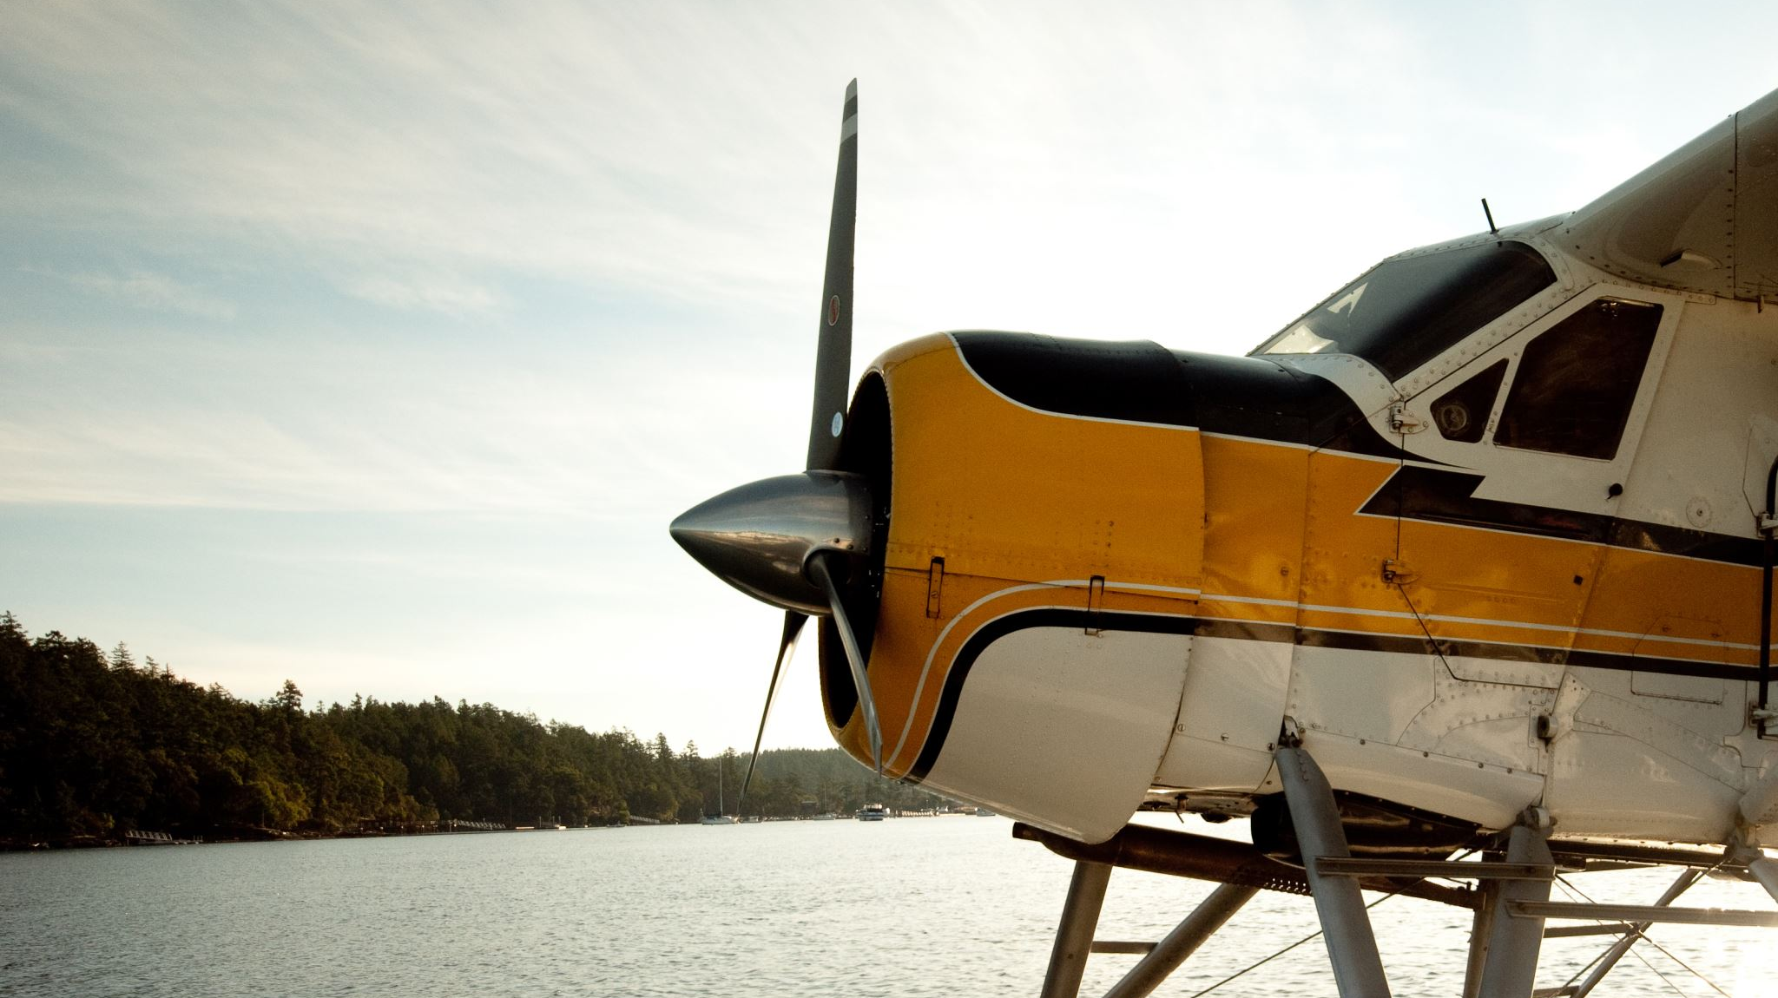
FINAL MODEL
Based on our predictive accuracy, we chose to pursue with Decision Tree Model
The No Information Rate for the Model is 0.5622, i.e whenever we predicted Neutral/Dissatisfied, we were only 56.22% times correct
But with our model we achieved a predictive accuracy of 0.7894, which means we are whenever we predicted Satisfied, we were 78.94% times correct

Slide 47

ADVANTAGES OF DECISION TREE
Simple to understand, interpret, visualize
Decision trees implicitly perform variable screening or feature selection
Can handle both numerical and categorical data. Can also handle multi-output problems
Decision trees require relatively little effort from users for data preparation
Nonlinear relationships between parameters do not affect tree performance

Slide 48
Decision Tree: Limitations
Unstable Nature
One of the drawbacks of Decision Trees is that they are very unstable when compared to other choice predictors. A small change in the data can result in a major change in the structure of the decision tree, which can convey a different result from what users will get in a normal event.
Less Effective in Predicting the Outcome of a Continuous Variable
In addition, decision trees are less effective in making predictions when the main goal is to predict the outcome of a continuous variable.

Slide 49
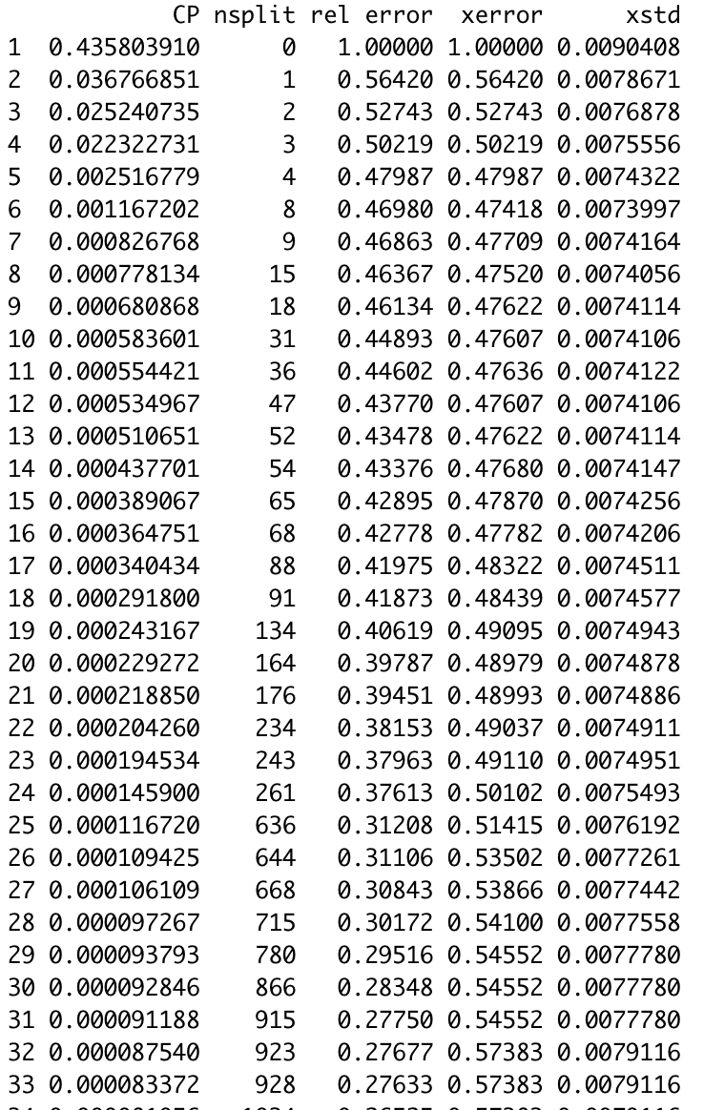
Improving The Model
1. CATBOOST OR BUST
2. ROAMING THE RANDOM FOREST
3. PRUNING THE TREE
1. We can prune the tree to enhance the accuracy.
2. Considering optimal error rate to prune the tree.
Notes:
To enhance Decision Trees is to use a technique called Gradient Boosting. The leading Gradient Boosting technique for decision trees is an implementation called CatBoost and it is the algorithm. With a decision tree, gradient boosting works like this: First, build a simple decision tree. For every observation in your training data, record the error in the prediction it makes. Then build another decision tree to predict that error. Combine the original prediction and the prediction of the error to generate an updated and improved prediction. Record the error in that updated prediction and build another decision tree to predict that error.

Slide 50
RECOMMENDATIONS

Slide 51
IMPROVE SPECIFIC AREAS OF AIRLINE SERVICE
We can suggest improvements to the following services based on the individual service ratings because their average was lower than others
In-flight Wi-Fi service: This service has consistently lower average ratings across different demographics, and we can see from the variable importance plots that it is a major factor in customer satisfaction, so more effort must be put into improving in-flight Wi-Fi services
Ease of online booking: We would recommend improving online booking services to provide a more seamless experience for customers when booking their travel. This can include updating the website and app as well as creating a better customer service portal
Gate Location: Optimize gate locations so that customers must walk less distance while transiting
Food and Beverage: Improve the quality of food and beverages served on board

Slide 52
INCREASE CUSTOMER RELATIONS AND SATISFACTION
It is observed that people who traveled in business class and for business purposes were more satisfied.
We can cater to such travelers and highlight some of the services that received higher average ratings.
We can use the following services as best in class while advertising and thus help in getting more customers. For instance, there can be a campaign showing off the In-flight services of the airline which any way attract passengers.
In-Flight Service
Check In-service
Baggage Handling
Legroom service
Onboard service
Inflight entertainment
Seat comfort
Online boarding

Slide 53
INCREASE THE PROFIT MARGIN OF THE COMPANY
Happy customers mean more loyal customers thus, the chances that the customer will fly with the airline again is higher. This will help in bringing in more revenue and thus, a better profit margin. This is the overall impact of the activity.
Ratings could be related to Profit margin directly, as Southwest airlines is a 4-star rated airline as compared to American Airlines which is a 3-star rated one. (according to Skytraxratings.com)
We can also offer more discounted loyalty programs to economy plus and economy travelers and increase satisfaction for Loyal customers. Business-class travelers are more likely to take part in loyalty programs as they constitute the majority of people who are satisfied with the service.

Slide 54
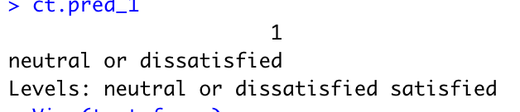
PREDICTING SATISFACTION RATING OF NEW CUSTOMER
Gender: MALE - AGE: 43 - Class: BUSINESS CLASS - Total Miles: 1235 - Type of Travel: PERSONAL TRAVEL
RECOMMENDATIONS FOR PREDICTED DISSATISFIED OR NEUTRAL PASSENGER
Based on the historic data for Male Passengers in the Age group of 40 – 59, Traveling in Business Class for Personal Purpose, we can suggest improvements to airline services such as :
EASE OF ONLINE BOOKING
WEB CHECK-IN SERVICE
PRE-BOARDING SEAT SELECTION
SEAT COMFORT
PRE-SELECTION OF PREFERED FOOD AND DRINKS
could significantly enhance customer satisfaction, and possibly help the airline generate more revenue by retaining the passengers and converting them into their frequent flyers.
**We can further provide the Predicted Dissatisfied Customer with incentives such as Discounts, Free In-Flight WIFI, etc to improve their In-Flight experience
INPUT
OUTPUT
TEST CASE 101

Slide 55

THANK YOU

